Slide 1


Console App
Bank Operations

Slide 2

CONTENT
01
Python and it’s Implementation
02
SCOPE OF PROJECT
03
Class Design 1
04
Class Design 2
05
Requirement Framing
06
Operating Environment
07
Summary of Application

Slide 3


Python
Python and it’s Implementation
High-level, interpreted programming language
It is object oriented programming language.
It’s Syntax is easy to implement then other programming language.
It uses in web development and machine learning.
It takes less time to execute.

Slide 4

SCOPE OF PROJECT
The scope of the Online Banking System project includes the following functionalities:
- - Account management (Create Account, Deposit Amount, Withdraw Amount).
Create Account – 1) Savings Account
2) Current Account
- Fund transfers between accounts.
- Balance Inquiries.

Slide 5
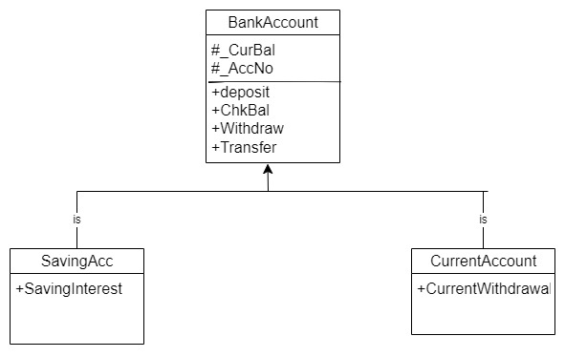
Class Design – Individual Classes

Slide 6
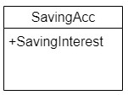
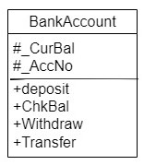
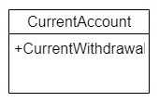

Class Design – On a Single Canvas

Slide 7
Functional Requirements of App

Slide 8
Requirement ID | Requirement CATEGORY | Requirement TYPE | PRIORITY | HIERARCHY | REF
R001 | FUNCTIONAL | STATED | HIGH
Requirement DESCRIPTION | Balance Check
SCOPE | The method is visible in the class object that want to check Balance.
METHODOLOGICAL DETAILS of Requirement | ChkBal() method is used to display the Balance.

Slide 9
Requirement ID | Requirement CATEGORY | Requirement TYPE | PRIORITY | HIERARCHY | REF
R002 | FUNCTIONAL | STATED | HIGH
Requirement DESCRIPTION | Deposit Money
SCOPE | The method Is visible in the class object that want to Deposit Money.
METHODOLOGICAL DETAILS of Requirement | The financial aspect should remain stable throughout the entire process. Deposit() method will be visible to deposit money. The methods should be reused.

Slide 10
Requirement ID | Requirement CATEGORY | Requirement TYPE | PRIORITY | HIERARCHY | REF
R003 | FUNCTIONAL | STATED | HIGH
Requirement DESCRIPTION | Withdraw Money
SCOPE | The method is visible in the class object that want to Withdraw money.
METHODOLOGICAL DETAILS of Requirement | The financial aspect should remain stable throughout the entire process. Funds that are added and removed should be accurately represented in the relevant account. Withdraw() method will be visible to withdraw money. The methods should be reused.

Slide 11
Requirement ID | Requirement CATEGORY | Requirement TYPE | PRIORITY | HIERARCHY | REF
R004 | FUNCTIONAL | STATED | HIGH
Requirement DESCRIPTION | Transfer Money
SCOPE | The method is visible in the class object that want to Transfer money.
METHODOLOGICAL DETAILS of Requirement | The financial aspect should remain stable throughout the entire process. Funds that are added and removed during transfer should be accurately represented in the relevant account. Transfer() method will be visible to withdraw money. We will use deposit and withdraw functions in case of transfer funds.

Slide 12


IOS Python PyCharm
OPERATING ENVIRONMENT
Windows
Python PyCharm
Linux
EasyEclipse
Docker

Slide 13
SUMMARY OF APPLICATION
While working on this project, I got to learn and work on various concepts and aspects of object oriented programming in python.
This project utilizes inheritance, polymorphism, encapsulation and other important features of object oriented programming along with effective use of different abstraction.
With some modifications in implementation, codes and by creating a UI, this project can also be helpful in real life banking system application.
This project is a good starting point for beginners who want to learn python.

Slide 14

THANK YOU
By : Pratyush Kumar (200637)
Technology Integration Engineer
Smartops-Fusion

